Slide 1

INTRODUCTION TO SPARK STREAMING

Slide 2
Project Tips/Ideas
You can start working with your final project:
↘ Defining the use-case
↘ Input Data Sources
↘ Which problem you aim to solve?
↘ What is the benefit of Streaming?
Examples:
↘Twitter Sentiment Analysis on Near-Real Time With Streaming Data: Not only obtaining tweets but also doing sentiment Analysis
↘Getting Financial Data and Spot trends. Using historical transactions as input.
↘Get google trends in Real Time using google API and Spot Patterns
↘Your idea….

Slide 3
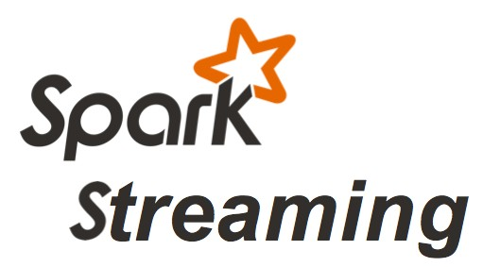
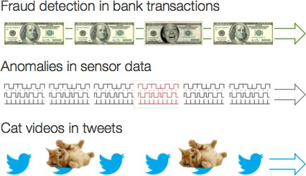
Use Cases Recap

Slide 4
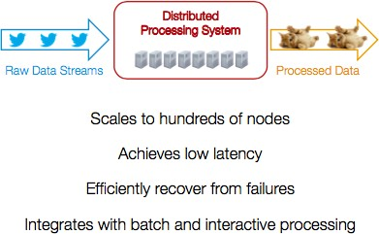
Distributed Streaming System

Slide 5
Technical Solutions
Existing frameworks cannot do Batch&Stream.
↘Either, Stream of 100s of MB/s with low latency
↘Or, batch processing of TBs of data with high latency
Extremely painful to maintain two systems (Lambda Architecture)
↘Different programming models
↘Doubles implementation effort
↘Doubles operational effort
Kappa Architecture (only 1 stack): Kafka and Spark Streaming

Slide 7
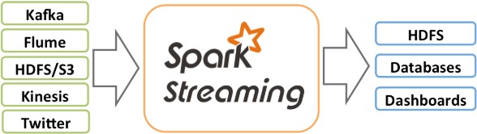
What is Spark Streaming?
Is an extension of the core Spark API that enables scalable, high throughput and fault-tolerant stream processing.
Receive data streams from input sources, process them in a cluster, push out to databases/dashboards.
Scalable, fault-tolerant, second-scale latencies
-

Slide 8
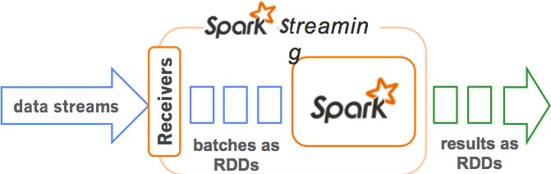
How does Spark Streaming Work?
Chop up data streams into batches of few secs
Spark treats each batch of data as RDDs and processes them using RDD operations
Processed results are pushed out in batches

Slide 9
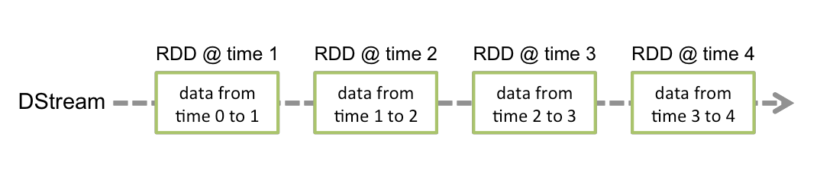
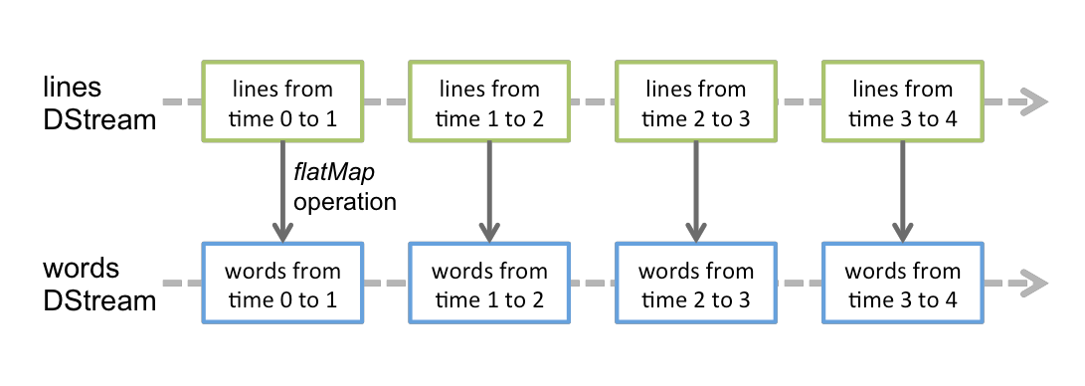
Discretized Streams (DStreams)
Basic abstraction provided. Represent a continuous stream of data.
Any operation applied on a DStream translates to operations on the underlying RDDs.

Slide 10
Spark Streaming Programming Model
Provides a high level abstraction called discretized stream or DStream
↘Represents a Stream of Data
↘Is a sequence of RDDs.
DStreams API very similar to RDD API
↘Functional APIs in Scala, Java and Python
↘Create input DStreams from different sources
↘Apply parallel operations

Slide 11
Spark Streaming: Input Sources
Out of the box provide:
↘Kafka, Flume, Kinesis, Raw TCP sockets, HDFS, etc….
Very easy to write a custom receiver
↘Define what to do when receiver is started and stopped
Also, generate your own sequence of RDDs and push them in as a ”stream”.

Slide 12
Spark Streaming: Output Sources
HDFS, S3, etc (Hadoop API compatible filesystems)
Cassandra (using Spark-Cassandra connector)
Hbase
Directly push the data anywhere

Slide 13
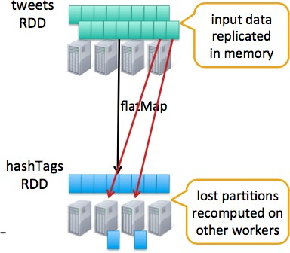
Spark Streaming: Fault-Tolerance
Batches of input data are replicated in memory for fault-tolerance.
Data lost due to worker failure, can be recomputed from replicated input data
All transformations are fault-tolerant and exactly-once transformations.

Slide 14
Twitter Example

Slide 15
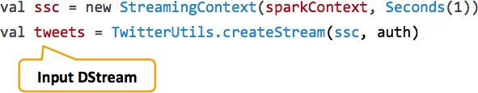
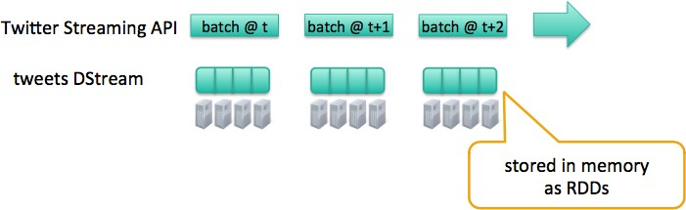
Example: Get hashtags from Twitter
Connect to twitter API

Slide 16
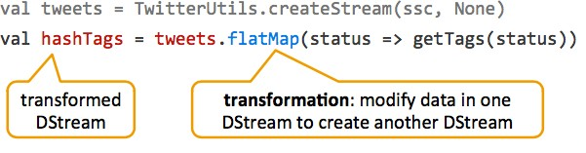
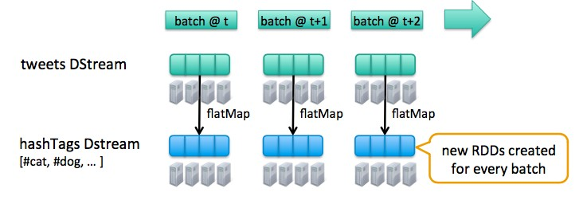
Example: Get hashtags from Twitter
Divided the tweets DStream into HashTags

Slide 17
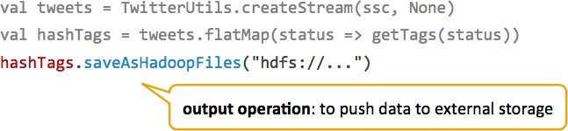
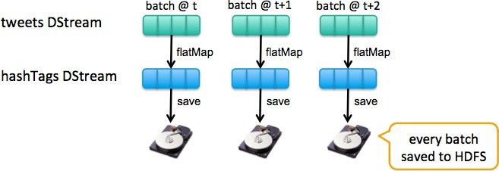
Example: Get hashtags from Twitter
Store the hashtags in hdfs

Slide 18
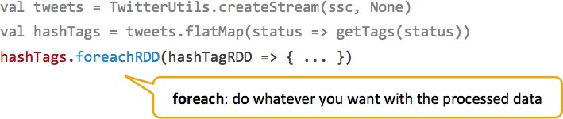
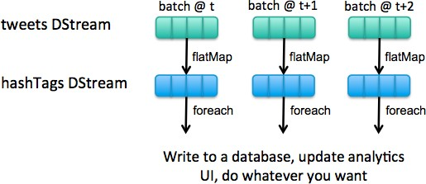
Example: Get hashtags from Twitter
For each hashtag do something

Slide 19
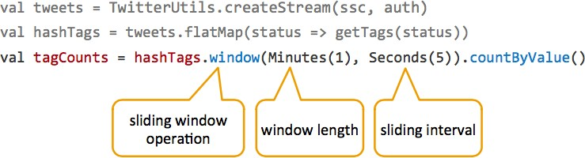
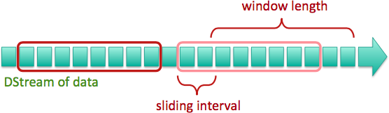
Example: Get hashtags from Twitter
Window-based transformations

Slide 20
Live Example

Slide 21
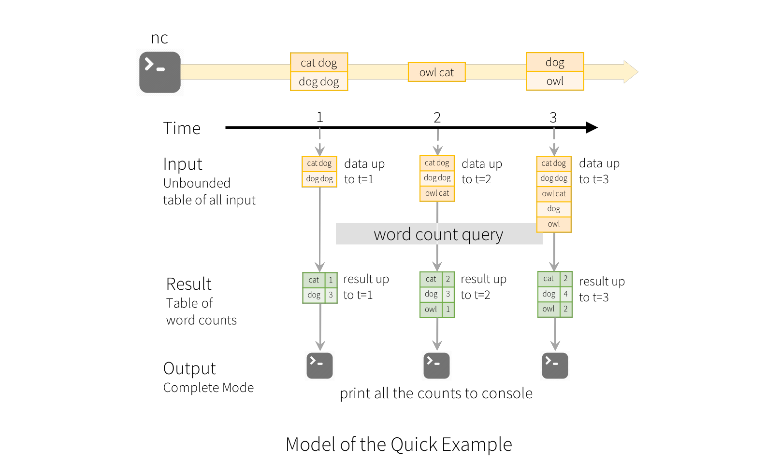

Slide 22
Live Example: WordCount from TCP Socket
We want to count the number of words in text data received from a data server listening on a TCP socket.
To execute:
↘ Launch the SERVER Spark Streaming Application:
01_STREAMING_SERVER_word_count_streaming_updateByStateKey.ipynb
↘Launch the CALLER Application:
02_STREAMING_CALLER_word_count_streaming_updateByStateKey.ipynb

Slide 23
Code
from pyspark import SparkContext
from pyspark.streaming import StreamingContext
# Create a local StreamingContext with two working thread and batch interval of 1 second sc = SparkContext("local[2]", "NetworkWordCount")
sc.setLogLevel("ERROR")
ssc = StreamingContext(sc, 10)
# Create a DStream that will connect to hostname:port, like localhost:9999 lines = ssc.socketTextStream("localhost", 10002)
# Split each line into words
words = lines.flatMap(lambda line: line.split(" "))
# Count each word in each batch
pairs = words.map(lambda word: (word, 1))
wordCounts = pairs.reduceByKey(lambda x, y: x + y)
# Print the first ten elements of each RDD generated in this DStream to the console wordCounts.pprint()
ssc.start() # Start the computation ssc.awaitTermination() # Wait for the computation to terminate

Slide 24
Relevant Notes
Once a context has been started, no new streaming computations can be set up or added to it.
Once a context has been stopped, it cannot be restarted.
Only one StreamingContext can be active in a JVM at the same time.
stop() on StreamingContext also stops the SparkContext. To stop only the StreamingContext, stop() with stopSparkContext parameter to false.
A SparkContext can be re-used to create multiple StreamingContexts as long as the previous StreamingContext is stopped (without stopping the SparkContextt) before the next StreamingContext is created.

Slide 25
3. Window Operations

Slide 26
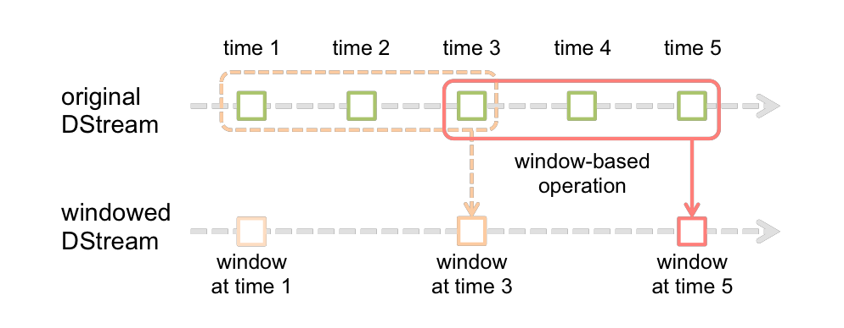
Window Operations
Every time the window slides over a source DStream, the source RDDs that fall within the window are combined and operated upon to produce the RDDs of the windowed DStream.
In this specific case, the operation is applied over the last 3 time units of data, and slides by 2 time units. This shows that any window operation needs to specify two parameters:
Window length: The duration of the window (3 in the figure)
Sliding Interval: The interval at which the window operation is performed (2 in the figure) These two parameters must be multiple of the batch interval (1 in the figure).

Slide 27
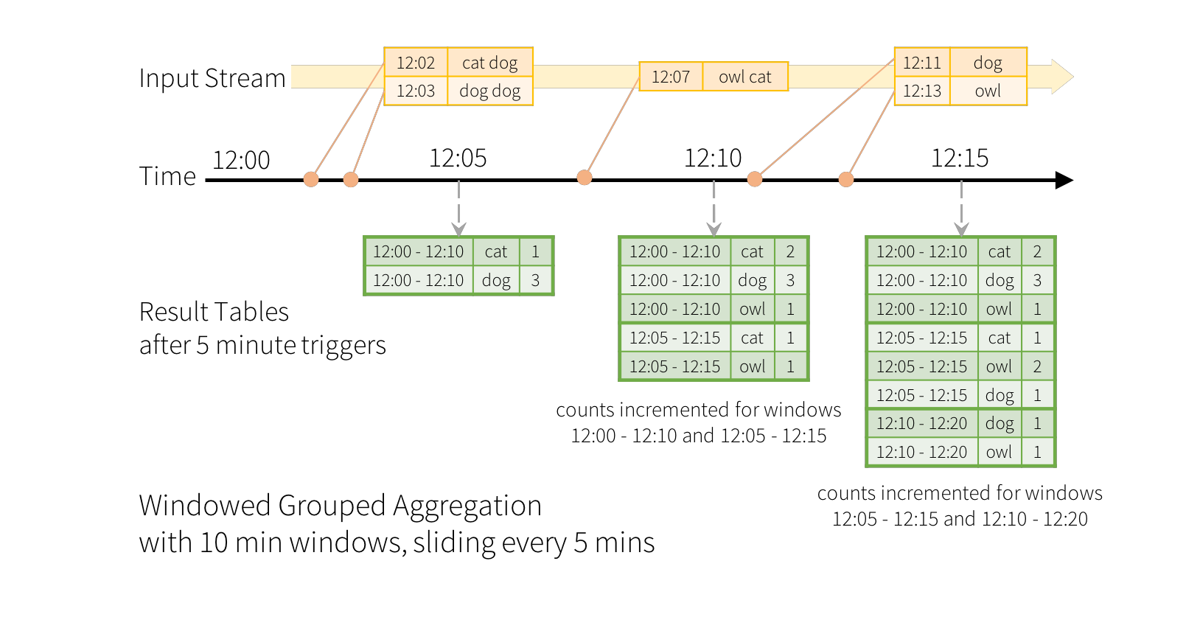

Slide 28
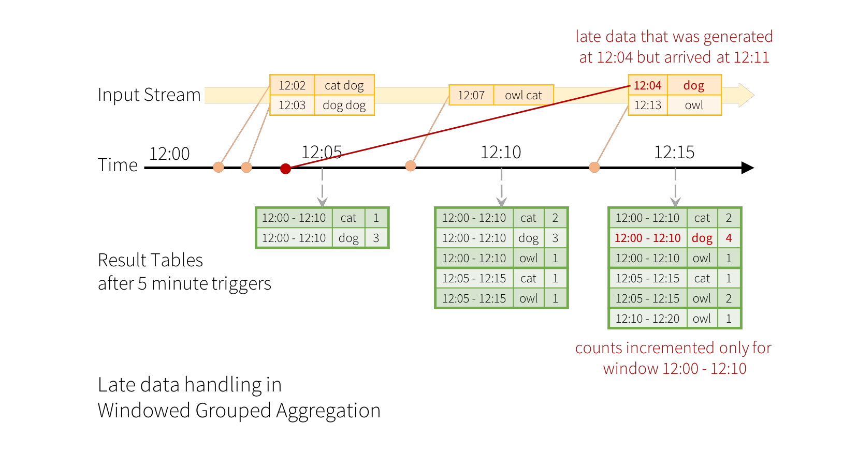

Slide 29
Window Operations: Example
Generate the word counts over the last 30 seconds of data, every 10 seconds
# Reduce last 30 seconds of data, every 10 seconds
windowedWordCounts = pairs.reduceByKeyAndWindow(lambda x, y: x + y, lambda x, y: x - y, 30, 10)

Slide 30
Window Examples

Slide 31
4. Keeping the State: updateStateByKey

Slide 33
updateStateBykey Operation
The updateStateByKey operation allows you to maintain arbitrary state while continuously updating it with new information. To use this, you will have to do two steps.
↘ Define the state
↘ Define the state update function – Specify with a function how to update the state using the previous state and the new values from an input stream.
In every batch, spark will apply the state update function for all existing keys, regardless of whether they have new data in a batch or not.

Slide 34
updateStateBykey Operation Example
def updateFunction(newValues, runningCount): if runningCount is None:
runningCount = 0
return sum(newValues, runningCount) # add the new values with the previous running count
This is applied on a DStream containing words (say, the pairs DStream containing (word, 1)
runningCounts = pairs.updateStateByKey(updateFunction)
The update function will be called for each word, with newValues having a sequence of 1’s (from the (word, 1) pairs) and the runningCount having the previous count.
Note that requires the checkpoint directory

Slide 35
Keeping the State: updateStateByKey
updateStateByKey(func)
Return a new "state" DStream where the state for each key is updated by applying the given function on the previous state of the key and the new values for the key. This can be used to maintain arbitrary state data for each key.

Slide 36
Keeping the State: Example

Slide 37
5. Summary Transformations on DStreams

Slide 38
Window Operations
All take two parameters – windowLength and slideInterval
Transformation | Meaning
window(windowLength, slideInterval) | Return a new DStream which is computed based on windowed batches of the source DStream.
countByWindow(windowLength, slideInterval) | Return a sliding window count of elements in the stream.
reduceByWindow(func, windowLength, slideInterval)) | Return a new single-element stream, created by aggregating elements in the stream over a sliding interval using func. The function should be associative so that it can be computed correctly in parallel.
reduceByKeyAndWindow(func, windowLength, slideInterval, [numTasks]) | When called on a DStream of (K, V) pairs, returns a new DStream of (K, V) pairs where the values for each key are aggregated using the given reduce function func over batches in a sliding window. Note: By default, this uses Spark's default number of parallel tasks (2 for local mode, and in cluster mode the number is determined by the config property spark.default.parallelism) to do the grouping. You can pass an optional numTasks argument to set a different number of tasks.

Slide 39
Window Operations
All take two parameters – windowLength and slideInterval
Transformation | Meaning
reduceByKeyAndWindow(func, invfunc, windowLength, slideInterval, [numTasks]) | A more efficient version of the above reduceByKeyAndWindow() where the reduce value of each window is calculated incrementally using the reduce values of the previous window. This is done by reducing the new data that enters the sliding window, and “inverse reducing” the old data that leaves the window. An example would be that of “adding” and “subtracting” counts of keys as the window slides. However, it is applicable only to “invertible reduce functions”, that is, those reduce functions which have a corresponding “inverse reduce” function (taken as parameter invFunc). Like in reduceByKeyAndWindow, the number of reduce tasks is configurable through an optional argument.
countByValueAndWindow(windowLength, slideInterval, [numTasks]) | When called on a DStream of (K, V) pairs, returns a new DStream of (K, Long) pairs where the value of each key is its frequency within a sliding window. Like in reduceByKeyAndWindow, the number of reduce tasks is configurable through an optional argument.

Slide 40
Transformations on DStreams
Allows the data from the input DStream to be modified
Transformation | Meaning
map(func) | Return a new DStream by passing each element of the source DStream thorugh a function func
flatMap(func) | Similar to map but each input item can be mapped to 0 or more output items
filter(func) | Return a new DStream by selecting only the records of the source DStream on which func returns true
repartition(numPartitions) | Change the level of parallelism in this DStream by creating more or fewer partitions
union(otherStream) | Return a new DStream that contains the union of the elements in the source DStream and other DStream

Slide 41
Transformations on DStreams
Allows the data from the input DStream to be modified.
Transformation | Meaning
count() | Return a new DStream of single-element RDDs by counting the number of elements in each RDD of the source DStream
reduce(func) | Return a new DStream of single-element RDDs by aggregating the elements in each RDD of the source DStream using a function func (which takes two arguments and returns one). The function should be associative so that it can be computed in parallel.
countByValue() | When called on a DStream of elements of type K, return a new DStream of (K, Long) pairs where the value of each key is its frequency in each RDD of the source DStream.

Slide 42
Transformations on DStreams
Allows the data from the input DStream to be modified.
Transformation | Meaning
reduceByKey(func, [numTasks]) | When called on a DStream of (K, V) pairs, return a new DStream of (K, V) pairs where the values for each key are aggregated using the given reduce function. Note: By default, this uses Spark's default number of parallel tasks (2 for local mode, and in cluster mode the number is determined by the config property spark.default.parallelism) to do the grouping. You can pass an optional numTasks argument to set a different number of tasks.
join(otherStream, [numTasks]) | When called on two DStreams of (K, V) and (K, W) pairs, return a new DStream of (K, (V, W)) pairs with all pairs of elements for each key.

Slide 43
Transformations on DStreams
Allows the data from the input DStream to be modified.
Transformation | Meaning
cogroup(otherStream, [numTasks]) | When called on a DStream of (K, V) and (K, W) pairs, return a new DStream of (K, Seq[V], Seq[W]) tuples.
transform(func) | Return a new DStream by applying a RDD-to-RDD function to every RDD of the source DStream. This can be used to do arbitrary RDD operations on the DStream.
updateStateByKey(func) | Return a new "state" DStream where the state for each key is updated by applying the given function on the previous state of the key and the new values for the key. This can be used to maintain arbitrary state data for each key.

Slide 44
Output Operations on DStreams
Transformation | Meaning
saveAsTextFiles(prefix, [suffix]) | Save this DStream's contents as text files. The file name at each batch interval is generated based on prefix and suffix: "prefix-TIME_IN_MS[.suffix]".
foreachRDD(func) | The most generic output operator that applies a function, func, to each RDD generated from the stream. This function should push the data in each RDD to an external system, such as saving the RDD to files, or writing it over the network to a database. Note that the function func is executed in the driver process running the streaming application, and will usually have RDD actions in it that will force the computation of the streaming RDDs.

Slide 45
7. Recap Examples

Slide 46
Examples Recap
reduceByKey
pairs = words.map(lambda word: (word, 1)) wordCounts = pairs.reduceByKey(lambda x, y: x + y)
updateStateByKey
wordCounts = pairs.updateStateByKey(updateFunc)
reduceByKeyAndWindow
wordCounts = pairs.reduceByKeyAndWindow(lambda x, y: int(x) + int(y), 10, 2)
reduceByKeyAndWindow
wordCounts = pairs.reduceByKeyAndWindow(lambda x, y: int(x) + int(y), lambda x, y: int(x) - int(y), 10, 2)
join
wordCounts1 = pairs.reduceByKey(lambda x, y: x + y)
wordCounts2 = pairs.reduceByKey(lambda x, y: (x + y)**2) wordCounts = wordCounts1.join(wordCounts2)

Slide 47
INTRODUCTION TO SPARK STREAMING

